Slide 1

Naidupeta,
Quality & Control Reviews

Slide 2


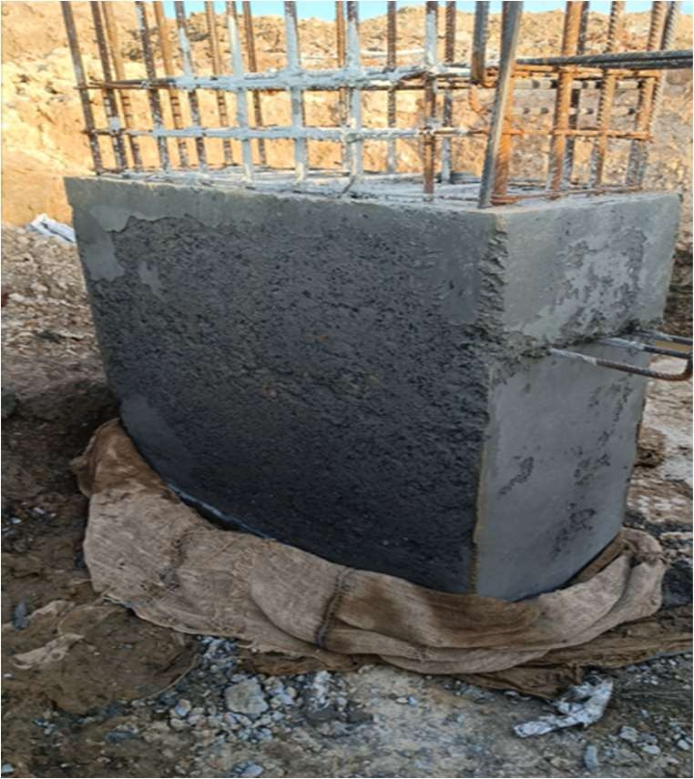
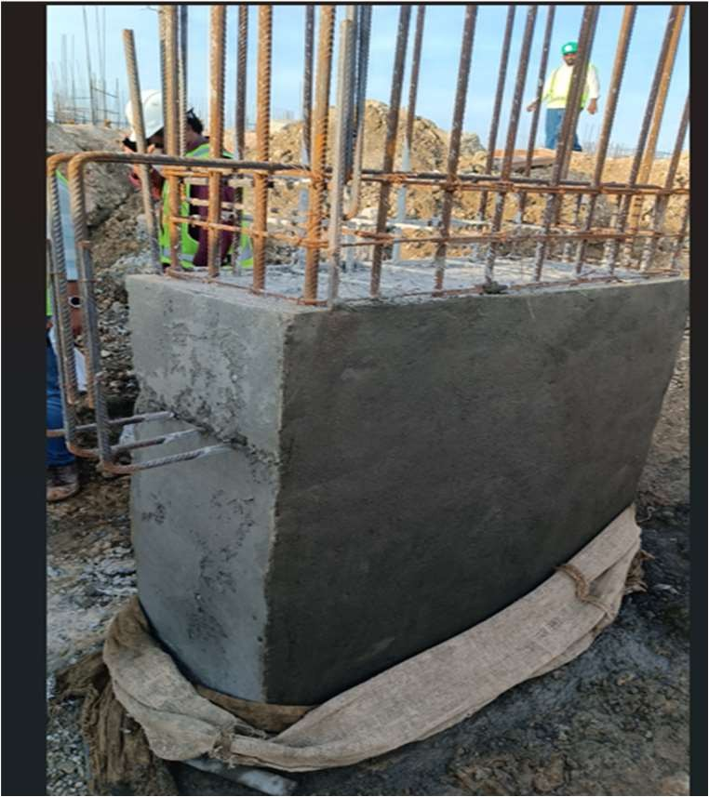
AC2
High
u
Medium
LOW
AC1
4.1 Establishment of NCR Process Required(1/2)
Risk Implication |  |  | Observation: Major Issue observed during site visit: During site inspection, Column at Grid S:11 was found with multiple critical deficiencies: poor compaction, concrete segregation, inadequate use of vibrators, misalignment of shuttering, honeycombing, and substandard concrete quality. These defects were concealed under a rug, raising serious concerns about structural integrity and quality control. Further, the same was discussed with the site in-charge at the location to implement corrective action on an immediate basis. After the audit highlighted the issue, corrective action was executed — the column was subsequently dismantled and re-cast; however, as there was no NCR process in place, the defect was not formally recorded, and the associated penalty should not be imposed on the contractor. Rework and cover with mortar Irregular shape due to is visible improper shuttering Structural deformation, segregation and irregularity observed
Financial Loss | u
Controls In- effectiveness | u
Regulatory non – Compliance
Incorrect reporting | u
Improvement | u
Root Cause
Design deficiency | u
Operating ineffectiveness | u
System deficiency | u
Remediation
Formation of SOP / Policy
Process Design | u
Staff Training | u
Defining Role and Responsibility | u
Automate control | u
Risk Implication
Financial Loss
Controls In- √
effectiveness
Regulatory non – Compliance
Incorrect reporting Improvement √
Root Cause
Design deficiency
Operating √
ineffectiveness
System deficiency
Remediation
Formation of SOP / Policy
Process Design
Staff Training √
Defining Role and √ Responsibility
Automate control
© 2025 Protiviti India Member Private Limited
CONFIDENTIAL : This document is for your organization's internal use only and should not be copied or distributed to any third party.

Slide 3
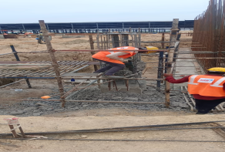
5.1 Improvement in Quality Documentation (1/3)
High
LOW
Medium
a
Risk Implication
Financial Loss
Controls In-effectiveness | a
Regulatory non – Compliance
Incorrect reporting | a
Improvement
Root Cause
Design deficiency | a
Operating ineffectiveness | a
System deficiency | a
Remediation
Formation of SOP / Policy | a
Process Design | a
Staff Training | a
Defining Role and Responsibility | a
Automate control
The observed condition was not a case of rework or mortar patch repair. The concrete skin was removed during de-shuttering due to shuttering issues. Considering the quality implications, the column was fully demolished and subsequently reconstructed as per approved drawings and specifications. Hence, no repaired or defective concrete remains in the permanent structure.
Corrective Action Implemented: The affected column was completely demolished up to pedestal level. Reconstruction of the column was carried out in accordance with approved drawings, specifications, and standard concreting practices, ensuring proper shuttering alignment, adequate vibration, and quality control supervision.
Post-reconstruction inspection confirmed that the column is free from surface defects, honeycombing, segregation, or dimensional irregularities. The reconstructed column complies with structural and quality requirements.

Slide 4

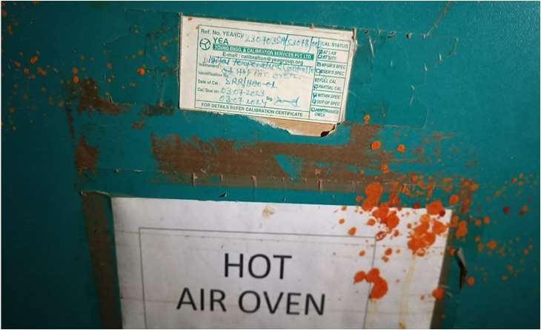
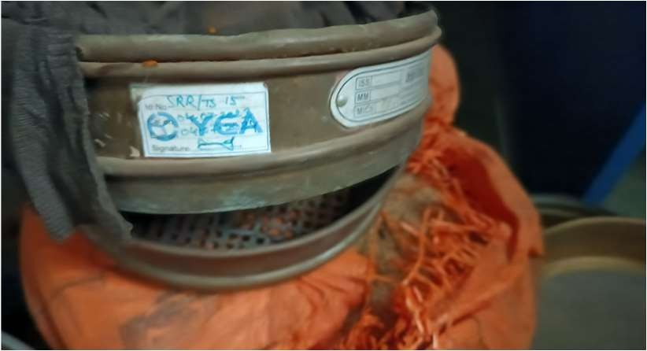
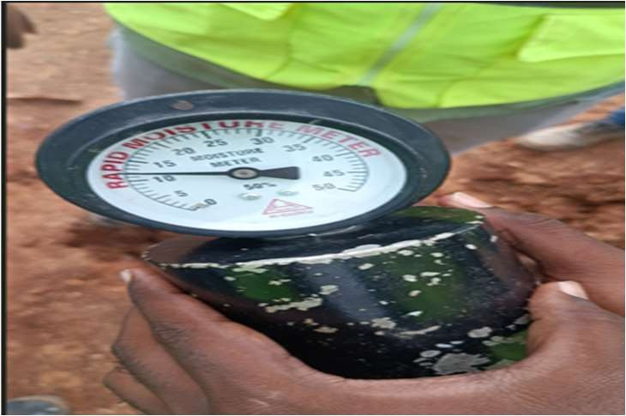
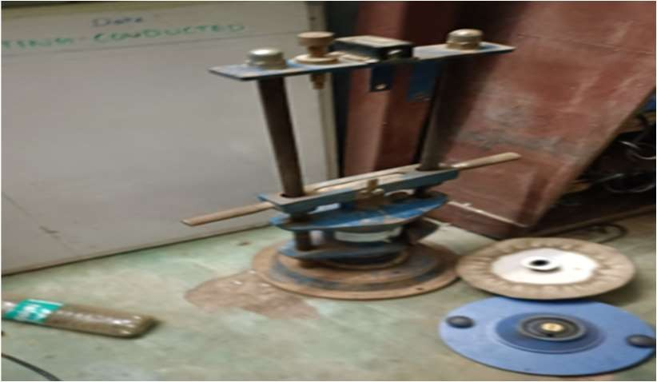
4.2 Strengthen Instrument Maintenance Framework(1/3)
High
u
Medium
LOW
Risk Implication |  |  | Observation: a. Un-calibrated equipment: During the site visit, it was observed that critical testing and measurement equipment—such as CTM, Moisture Meter, Slump Cone, Cube Molds, Sieves, Hot Oven, and Impact/Bulk Density testing devices—were either uncalibrated or had expired calibration validity. Additionally, the equipment list and calibration schedule were not available to validate the same. Also, this is in scope of contract. This activity falls under the contractor’s scope; however, it is supervised by the entity to ensure that the required work is executed and validated in accordance with applicable IS standards. Hot Air-Dry Oven (For moisture control) Sieve (Used for Sive analysis) (Moisture meter) Impact Testing Equipment
Financial Loss
Controls In- effectiveness | u
Regulatory non – Compliance | u
Incorrect reporting
Improvement | u
Root Cause
Design deficiency
Operating ineffectiveness | u
System deficiency | u
Remediation
Formation of SOP / Policy | u
Process Design | u
Staff Training | u
Defining Role and Responsibility | u
Automate control
Risk Implication
Financial Loss
Controls In- √
effectiveness
Regulatory non – Compliance
Incorrect reporting Improvement √
Root Cause
Design deficiency
Operating √
ineffectiveness
System deficiency
Remediation
Formation of SOP / Policy
Process Design
Staff Training √
Defining Role and √ Responsibility
Automate control

Slide 5
5.1 Improvement in Quality Documentation (1/3)
High
LOW
Medium
a
Risk Implication
Financial Loss
Controls In-effectiveness | a
Regulatory non – Compliance
Incorrect reporting | a
Improvement
Root Cause
Design deficiency | a
Operating ineffectiveness | a
System deficiency | a
Remediation
Formation of SOP / Policy | a
Process Design | a
Staff Training | a
Defining Role and Responsibility | a
Automate control
The uncalibrated equipment observed during the audit pertains to an old/non-operational laboratory which is not used for routine site testing. Currently, a new laboratory has been established, and all mandatory testing equipment, including the CTM, is in use with valid calibration certificates.

Slide 6
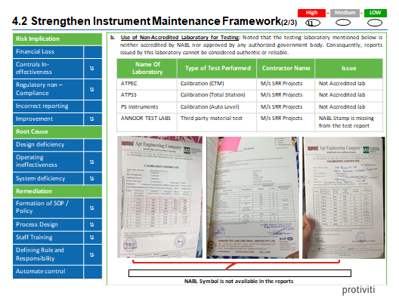
5.1 Improvement in Quality Documentation (1/3)
High
LOW
Medium
a
Risk Implication
Financial Loss
Controls In-effectiveness | a
Regulatory non – Compliance
Incorrect reporting | a
Improvement
Root Cause
Design deficiency | a
Operating ineffectiveness | a
System deficiency | a
Remediation
Formation of SOP / Policy | a
Process Design | a
Staff Training | a
Defining Role and Responsibility | a
Automate control

Slide 7
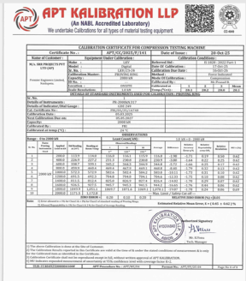


5.1 Improvement in Quality Documentation (1/3)
High
LOW
Medium
a
Risk Implication
Financial Loss
Controls In-effectiveness | a
Regulatory non – Compliance
Incorrect reporting | a
Improvement
Root Cause
Design deficiency | a
Operating ineffectiveness | a
System deficiency | a
Remediation
Formation of SOP / Policy | a
Process Design | a
Staff Training | a
Defining Role and Responsibility | a
Automate control
The observation is noted and clarified. The testing laboratory Annoor Test Labs and Engineering Services Pvt. Ltd. is NABL accredited as per ISO/IEC 17025:2017. Valid NABL accreditation certificate has been verified (valid up to 28-03-2026). Accordingly, test reports issued by the said laboratory are authentic and acceptable.

Slide 8
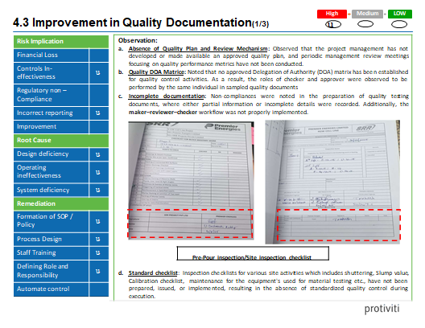
5.1 Improvement in Quality Documentation (1/3)
High
LOW
Medium
a
Risk Implication
Financial Loss
Controls In-effectiveness | a
Regulatory non – Compliance
Incorrect reporting | a
Improvement
Root Cause
Design deficiency | a
Operating ineffectiveness | a
System deficiency | a
Remediation
Formation of SOP / Policy | a
Process Design | a
Staff Training | a
Defining Role and Responsibility | a
Automate control

Slide 9
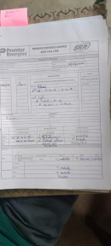
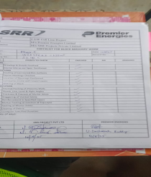

5.1 Improvement in Quality Documentation (1/3)
High
LOW
Medium
a
Risk Implication
Financial Loss
Controls In-effectiveness | a
Regulatory non – Compliance
Incorrect reporting | a
Improvement
Root Cause
Design deficiency | a
Operating ineffectiveness | a
System deficiency | a
Remediation
Formation of SOP / Policy | a
Process Design | a
Staff Training | a
Defining Role and Responsibility | a
Automate control
Periodic management review meetings on quality are being conducted with records maintained.

Slide 10
4.3 Improvement in Quality Documentation(2/3)
High
u
Medium
LOW
Risk Implication |  |  | Open quality & Inspection points: On review of checklists and test reports at the site, both during the visit and through documents received from the project team, it was observed that the checklists remained unsigned by the relevant approval authorities. In addition, instructions and issues identified by the site engineer for upcoming work shifts were not properly documented or mapped for follow-up and further analysis. Reply :All pending checklists and test reports have been reviewed, signed by the designated approval authorities, and filed for record. A systematic process has been implemented to ensure all instructions and observations by the site engineer are documented in the shift handover register and tracked for follow-up and closure. Site personnel have been trained on proper documentation, approval, and follow-up procedures for quality and inspection points. The process will be monitored to ensure compliance going forward. f. No Quality Engineer/ Department: It was noted that no dedicated Quality Department or designated Quality Engineer has been deployed at the project site. Quality-related tasks and oversight are being managed solely by the Site Engineers. Reply : Quality oversight and control activities are being effectively managed by the assigned Project Manager, who has the required experience and competence to handle all quality responsibilities. All quality-related tasks, checks, and approvals are being performed as per project quality requirements and documented accordingly. No non-conformities or quality issues were observed during verification
Financial Loss
Controls In- effectiveness | u
Regulatory non – Compliance
Incorrect reporting | u
Improvement
Root Cause
Design deficiency | u
Operating ineffectiveness | u
System deficiency | u
Remediation
Formation of SOP / Policy | u
Process Design | u
Staff Training | u
Defining Role and Responsibility | u
Automate control

Slide 11
4.3 Improvement in Quality Documentation(2/3)
High
u
Medium
LOW
Risk Implication |  |  | g. No Labs at the site locations: Noted that no dedicated material testing laboratory is prepared at the project site. Two contractors, M/s SRR and M/s CSR, are deployed at the site; however, a single external laboratory, owned by a third party, is being used jointly by both contractors. This arrangement may compromise timely testing, result reliability, and accountability of material quality verification. Reply :A dedicated on-site Quality Control lab is being established to support both contractors, equipped for all routine material testing. Standard operating procedures (SOPs) have been implemented to ensure timely sample collection, testing, and reporting. Responsibilities for material testing and result verification are clearly defined between contractors and the lab to maintain accountability and reliability. Interim arrangements with the existing third-party lab continue with a proper schedule to avoid delays in testing until the on-site lab is fully operational.
Financial Loss
Controls In- effectiveness | u
Regulatory non – Compliance
Incorrect reporting | u
Improvement
Root Cause
Design deficiency | u
Operating ineffectiveness | u
System deficiency | u
Remediation
Formation of SOP / Policy | u
Process Design | u
Staff Training | u
Defining Role and Responsibility | u
Automate control

Slide 12
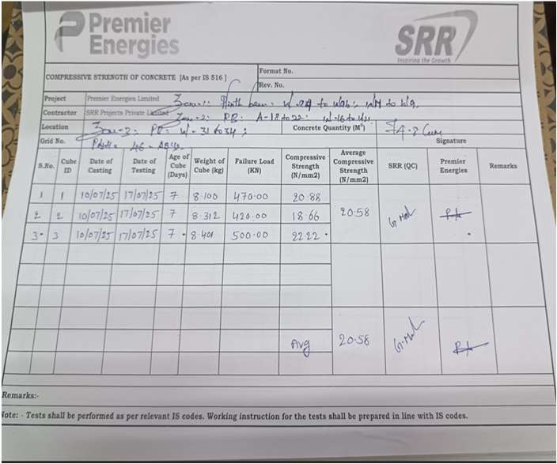
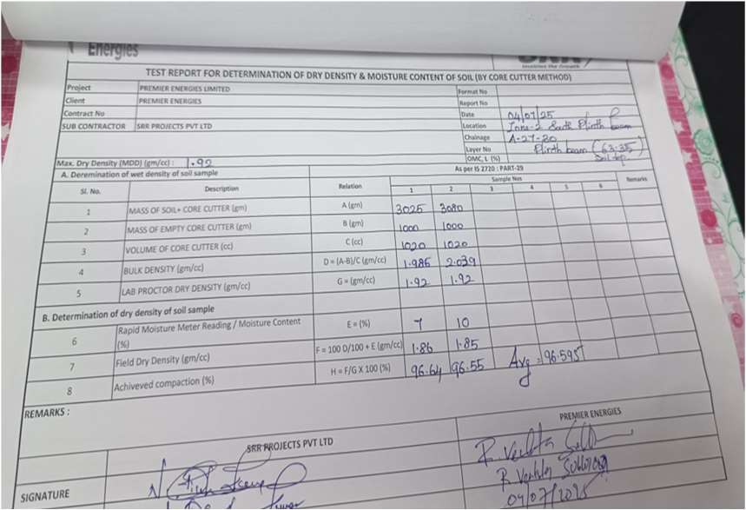
High
u
Medium
LOW
Risk Implication |  |  | h. No adherence to SOP: Noted that due to inadequate planning and lack of prioritization of quality assurance and control during project initiation, critical quality documents — namely the Quality Plan, approved Method Statement, and Inspection & Test Plan (ITP) — were not prepared or reviewed prior to commencement of work. Reply : As per IS 456:2000 and IS 516, the acceptance of concrete is based on 28-day compressive strength results. The code does not mandate a specific number of test specimens for 7-day testing; 7-day cube tests are only indicative for early strength monitoring and not for acceptance criteria. At site, three (3) cubes are tested at 7 days as a general industry practice to monitor strength development and quality trend. This practice is followed as an additional internal quality control measure, though not explicitly specified in IS Codes. Hence, the observation is clarified and closed, as the concrete quality acceptance is strictly ensured based on 28-day cube test results in compliance with IS standards.
Financial Loss
Controls In- effectiveness | u
Regulatory non – Compliance
Incorrect reporting | u
Improvement
Root Cause
Design deficiency | u
Operating ineffectiveness | u
System deficiency | u
Remediation
Formation of SOP / Policy | u
Process Design | u
Staff Training | u
Defining Role and Responsibility | u
Automate control
4.3 Improvement in Quality Documentation(2/3)

Slide 13
4.3 Improvement in Quality Documentation(3/3)
High
u
Medium
LOW
Risk Implication |  |  | Root Cause: Absence of a defined Quality Management System (QMS) with proper SOPs and governance mechanisms. Lack of prioritization of Quality Assurance and Control during project planning and execution. Absence of a formal monitoring and escalation mechanism for unresolved quality issues.. Impact: Inadequate quality oversight (no Quality Engineer/Dept.) can result in undetected errors, project delays, cost overruns, and reputational damage. Increased risk of structural defects, rework, and project delays due to unchecked execution errors. Recommendation: Develop, issue, and enforce inspection checklists for all key site activities (shuttering, slump test, calibration, equipment maintenance, etc.). Ensure all checklists and test reports are reviewed and signed by designated authorities (maker–checker– approver mechanism). Define a clear quality governance framework, including escalation matrices, periodic audits, and reporting dashboards for management visibility. Management Action Plan: Project quality control procedures shall be reviewed and aligned with applicable IS Codes, approved drawings, and technical specifications. Responsibilities of the QA/QC team and site execution team shall be clearly defined and communicated to ensure consistent implementation of quality requirements. Regular internal inspections and monitoring shall be carried out to identify deviations at an early stage and implement timely corrective actions. Records, checklists, and inspection reports shall be properly maintained, reviewed, and approved to ensure traceability and compliance. Periodic toolbox talks and awareness sessions shall be conducted for site engineers, supervisors, and workmen to prevent recurrence of similar observations. Timeline: Accountability: Mr. Nagapanendhar Rao Responsibility:
Financial Loss
Controls In- effectiveness | u
Regulatory non – Compliance
Incorrect reporting | u
Improvement
Root Cause
Design deficiency | u
Operating ineffectiveness | u
System deficiency | u
Remediation
Formation of SOP / Policy | u
Process Design | u
Staff Training | u
Defining Role and Responsibility | u
Automate control

Slide 14


Infrastructure & Civil Works Execution
© 2025 Protiviti India Member Private Limited
CONFIDENTIAL : This document is for your organization's internal use only and should not be copied or distributed to an
y third party.

Slide 15
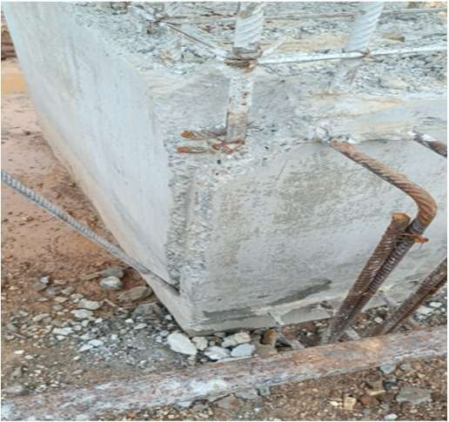
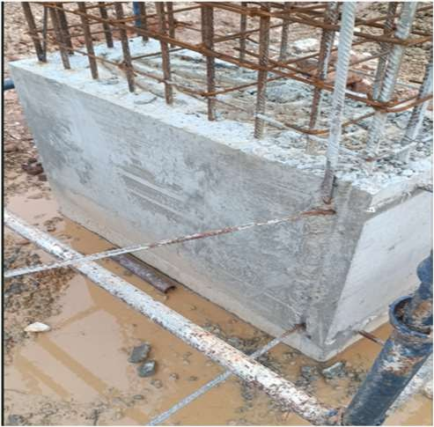
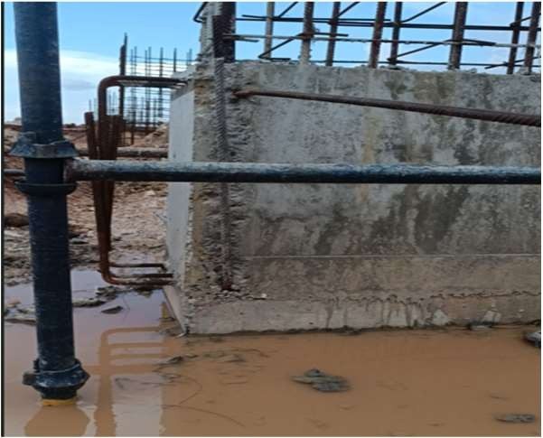
5.1 Opportunity to Improve Site Execution Quality(1/7)
High
u
Medium
LOW
Risk Implication |  |  | Observation: Issue pertaining to Honeycombing: Noted 5 instances out of 8 sample where honeycombing with voids and surface irregularities was observed in cast concrete structures, indicating inadequate compaction and consolidation during casting. Rebars visible _{Rebars visible} Honeycombing found in at multiple locations from column A:3 to A:9 & S:11) Closing point : All affected locations have been properly repaired using approved GP2 epoxy/repair mortar as per standard repair procedures. The repaired areas were finished, dressed, and cured, and surface integrity has been restored to acceptable standards. Repairs were inspected and accepted by the QA/QC team. Extra care shall be taken during de-shuttering, especially in areas with protruding plinth beam dowels and starters. Protective measures (buffer materials / controlled de-shuttering sequence) shall be implemented to prevent mechanical damage. Site engineers and supervisors shall be briefed and instructed on correct de-shuttering practices. QA/QC shall ensure close supervision during formwork removal for similar structural elements.
Financial Loss |  |  |  | AC1
Controls In- effectiveness | u
Regulatory non – Compliance
Incorrect reporting | u
Improvement | u
Root Cause
Design deficiency | u
Operating ineffectiveness | u
System deficiency | u
 |  |  |  | AC2
Remediation
Formation of SOP / Policy | u
Process Design
Staff Training | u
Defining Role and Responsibility | u
Automate control
Risk Implication
Financial Loss
Controls In- √
effectiveness
Regulatory non – Compliance
Incorrect reporting Improvement √
Root Cause
Design deficiency
Operating √
ineffectiveness
System deficiency
Remediation
Formation of SOP / Policy
Process Design
Staff Training √
Defining Role and √ Responsibility
Automate control
© 2025 Protiviti India Member Private Limited
CONFIDENTIAL : This document is for your organization's internal use only and should not be copied or distributed to any third party.

Slide 16
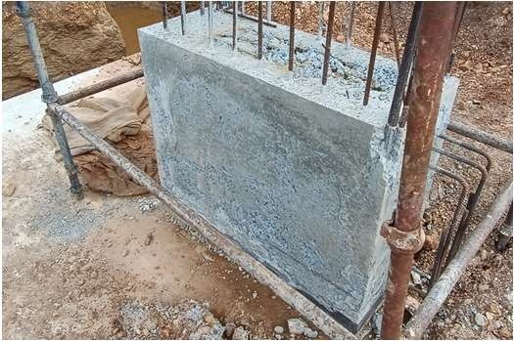
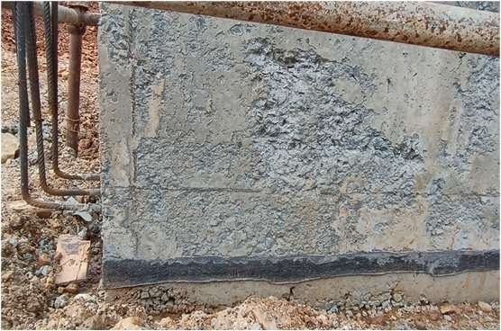
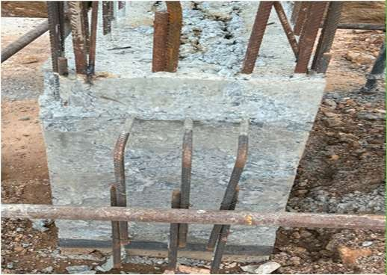
Risk Implication |  |  | Observation b . Concrete segregation due to improper shuttering: During the site inspection, 6 instances of concrete segregation were observed in structural elements. The affected areas showed uneven distribution of aggregates and paste, resulting from improper or complete lack of vibrator usage during placement and compaction. CLOING POINT : All affected locations were identified and rectified using approved repair mortar (GP2 / polymer-modified mortar) as per standard repair methodology. Loose and segregated concrete was removed, cleaned, and properly treated before repair. Repairs were finished, cured, and inspected by the QA/QC team and found satisfactory.
Financial Loss |  |  |  | AC1
Controls In- effectiveness | u
Regulatory non – Compliance
Incorrect reporting | u
Improvement | u
Root Cause
Design deficiency | u
Operating ineffectiveness | u
System deficiency | u
 |  |  |  | AC2
Remediation
Formation of SOP / Policy | u
Process Design
Staff Training | u
Defining Role and Responsibility | u
Automate control
5.1 Opportunity to Improve Site Execution Quality(1/7)
High
u
Medium
LOW
Risk Implication
Financial Loss
Controls In- √
effectiveness
Regulatory non – Compliance
Incorrect reporting Improvement √
Root Cause
Design deficiency
Operating √
ineffectiveness
System deficiency
Remediation
Formation of SOP / Policy
Process Design
Staff Training √
Defining Role and √ Responsibility
Automate control
© 2025 Protiviti India Member Private Limited
CONFIDENTIAL : This document is for your organization's internal use only and should not be copied or distributed to any third party.

Slide 17
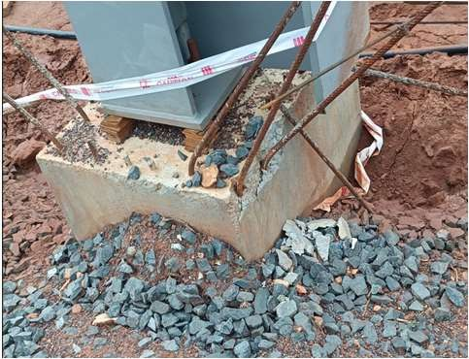
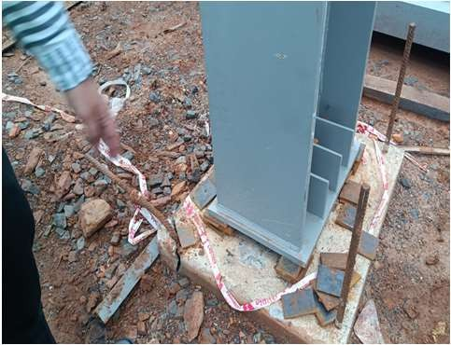
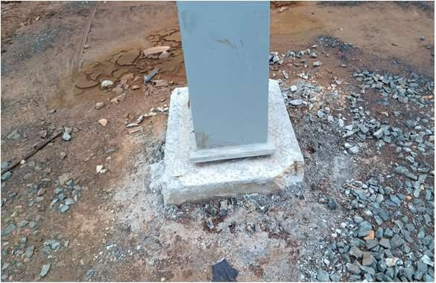
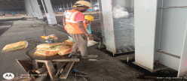
Risk Implication |  |  | Damage RCC column & top Observed: It was observed during the site visit that in 7 instances, discrepancies were noted in the RCC structures, where visible damages such as surface chipping, cracks, and exposed reinforcement were observed on RCC columns and their top portions. Multiple RCC columns were observed with bottom portion breakage at the PEB column interface CLOSING POINT All identified locations were thoroughly inspected by the QA/QC team. Shrinkage cracks were properly cleaned and sealed. Damaged concrete and exposed reinforcement were treated, cleaned, and protected as required. Approved GP2 repair mortar was applied to all affected areas. Repaired surfaces were properly finished and cured to restore durability and cover. The rectification works have been completed and verified.
Financial Loss
 |  |  |  | AC1
Controls In- effectiveness | u
Regulatory non – Compliance
Incorrect reporting | u
Improvement | u
Root Cause
Design deficiency | u
Operating ineffectiveness | u
 |  |  |  | AC2
System deficiency | u
Remediation
Formation of SOP / Policy | u
Process Design
Staff Training | u
Defining Role and Responsibility | u
Automate control
5.1 Opportunity to Improve Site Execution Quality(2/7)
High
u
Medium
LOW

Slide 18
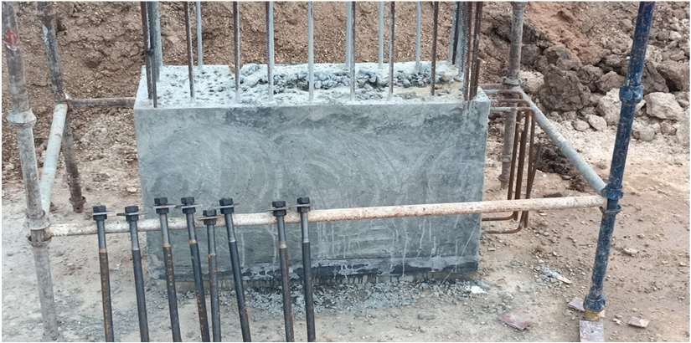
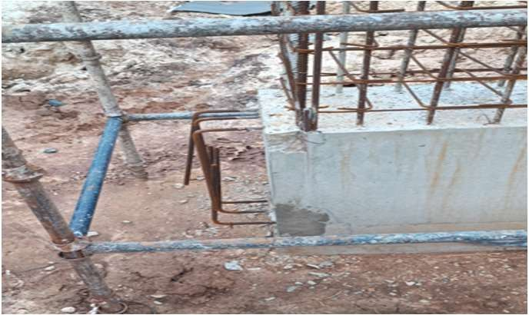
5.1 Opportunity to Improve Site Execution Quality(2/7)
High
u
Medium
LOW
Risk Implication |  |  | d. Re-work at multiple RCC structure: It was observed that in three instances, rework and repair activities had to be carried out on RCC columns, indicating deficiencies in the initial construction quality. Further, no Corrective and Preventive Action (CAPA) was raised to address the underlying cause of these defects. Re-work and repair work observed for multiple RCC structural element Closing point All affected RCC columns were properly repaired using approved repair methodology and GP2 repair mortar. Repairs were inspected and verified by the QA/QC team and found satisfactory. A formal CAPA has now been raised for the identified instances, documenting root causes and corrective actions.
Financial Loss
 |  |  |  | AC1
Controls In- effectiveness | u
Regulatory non – Compliance
Incorrect reporting | u
Improvement | u
Root Cause
Design deficiency | u
Operating ineffectiveness | u
 |  |  |  | AC2
System deficiency | u
Remediation
Formation of SOP / Policy | u
Process Design
Staff Training | u
Defining Role and Responsibility | u
Automate control

Slide 19
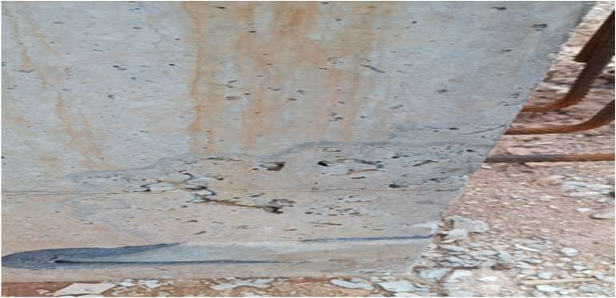
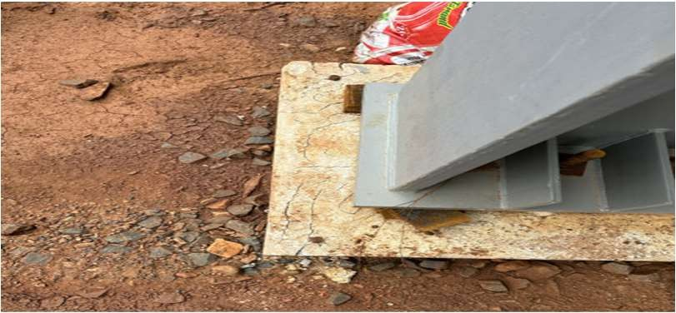
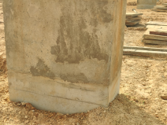
5.1 Opportunity to Improve Site Execution Quality(3/7)
High
u
Medium
LOW
Risk Implication |  |  | Voids and cracks found at RCC Column: Voids and cracks were observed in RCC columns at multiple locations within the ETP area, as well as at the bottom RCC base in Phase I. Voids in columns may allow water ingress, Cracks on the top surface indicate inadequate leading to reinforcement corrosion. curing. All affected areas were identified, cleaned, and rectified by removing loose concrete and sealing cracks. The voids and damaged portions were repaired using approved GP2 / polymer-modified repair mortar, followed by proper finishing and curing. The rectification works have been completed and inspected by the QA/QC team and found satisfactory. Preventive measures such as improved shuttering checks, adequate vibration during concreting, controlled de-shuttering, and proper curing practices have been implemented to avoid recurrence.
Financial Loss
Controls In- effectiveness | u
Regulatory non – Compliance
Incorrect reporting | u
Improvement | u
Root Cause
Design deficiency | u
Operating ineffectiveness | u
System deficiency | u
Remediation
Formation of SOP / Policy | u
Process Design
Staff Training | u
Defining Role and Responsibility | u
Automate control

Slide 20
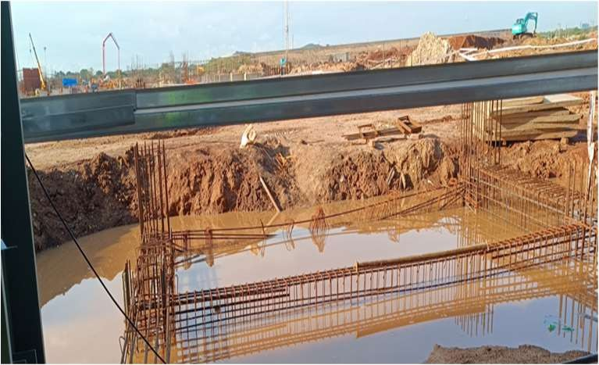
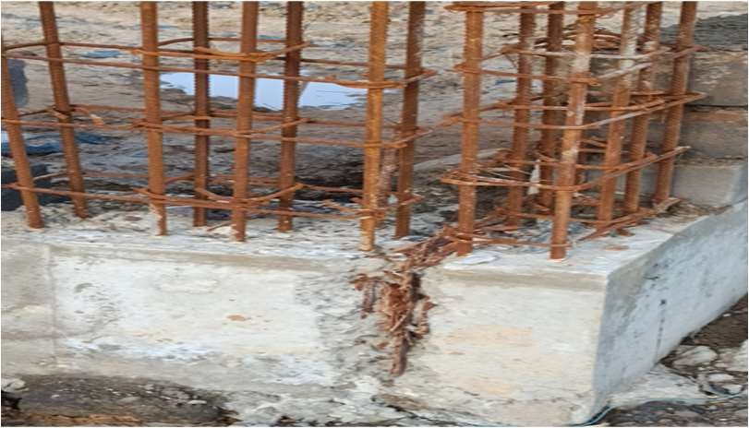
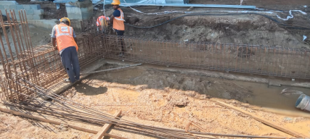
5.1 Opportunity to Improve Site Execution Quality(3/7)
High
u
Medium
LOW
Risk Implication |  |  | e. Rusted TMT bars used for Reinforcement: It was observed that most of the TMT bars used for footing and column reinforcement were heavily rusted, with no evidence of anti-rust coating or cement slurry application. Closing point : All affected reinforcement bars were thoroughly cleaned, and cement slurry coating was applied prior to concreting to ensure proper bond and protection. The reinforcement condition was verified by the QA/QC team before concrete placement. Necessary preventive instructions have been issued to ensure proper storage, cleaning, and protection of reinforcement in future works. Accordingly, the audit observation is hereby closed.
Financial Loss
Controls In- effectiveness | u
Regulatory non – Compliance
Incorrect reporting | u
Improvement | u
Root Cause
Design deficiency | u
Operating ineffectiveness | u
System deficiency | u
Remediation
Formation of SOP / Policy | u
Process Design
Staff Training | u
Defining Role and Responsibility | u
Automate control

Slide 21
5.1 Opportunity to Improve Site Execution Quality(4/7)
High
u
Medium
LOW
Risk Implication |  |  | g. Slump Value not recorded during pouring of concrete: It was noted during the site visit and validation of documents that the slump value was not recorded on the pour card or in the concrete checklist. g. Closer reply : A dedicated slump register has now been implemented and is being maintained, and slump values are recorded for every pour in the pour card and concrete checklist. QA/QC verification has been ensured prior to concreting. h. Issue observed regarding concreting during site visit: During site inspection, it was observed that a concreting activity using transit-mix concrete was carried out without collecting samples for slump testing or compressive strength evaluation. h. Closer reply :The issue has been addressed, and instructions have been issued to ensure mandatory slump testing and cube sample collection for every concrete pour. A slump register, cube casting register, and pour checklist are now being strictly maintained and verified by the QA/QC team prior to and during concreting j. PH meter is not available: Noted that no PH meter was available to validate the water PH value or the water used for casting and curing is fit for the use or not. Closer Reply : However, borewell water testing has already been carried out through an approved laboratory, and the water test report confirming suitability for construction purposes is available and was previously reviewed. Based on the test results, the water used for concreting and curing is fit for use as per relevant standards.
Financial Loss
Controls In- effectiveness | u
Regulatory non – Compliance
Incorrect reporting | u
Improvement | u
Root Cause
Design deficiency | u
Operating ineffectiveness | u
System deficiency | u
Remediation
Formation of SOP / Policy | u
Process Design
Staff Training | u
Defining Role and Responsibility | u
Automate control

Slide 22
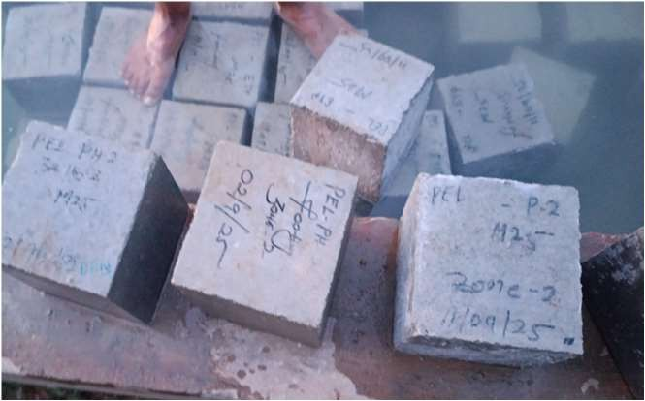

5.1 Opportunity to Improve Site Execution Quality(4/7)
High
u
Medium
LOW
Risk Implication |  |  | I . Inconsistency in cube identification mark: It was observed that concrete cubes prepared for testing did not have proper identification marks incorporated on the cube surface, leading to non-adherence with IS code requirements. Furthermore, the same curing tank was used for multiple entities, with no separate tanks maintained for 7:day and 28:day cube segregation. The issue has been addressed. Cube identification has now been properly marked on the cube surface with date of casting and location details, and records are maintained through the cube register, ensuring traceability. Although serial numbers were not marked earlier, identification adequacy has now been ensured. Further, systematic segregation and tagging of cubes for 7-day and 28-day testing has been implemented in the curing tank, and curing practices are being monitored by the QA/QC team.
Financial Loss
Controls In- effectiveness | u
Regulatory non – Compliance
Incorrect reporting | u
Improvement | u
Root Cause
Design deficiency | u
Operating ineffectiveness | u
System deficiency | u
Remediation
Formation of SOP / Policy | u
Process Design
Staff Training | u
Defining Role and Responsibility | u
Automate control

Slide 23
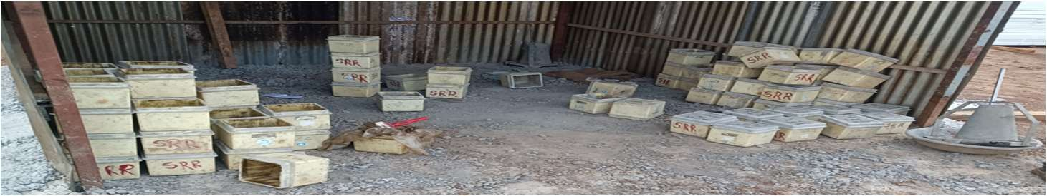
5.1 Opportunity to Improve Site Execution Quality(4/7)
High
u
Medium
LOW
Risk Implication |  |  | No ISI mark found on cube mold and slump cone: Concrete cube molds and slump cones lacked ISI marks, rendering the testing equipment noncompliant with IS 456:2000 and test results unverifiable. Closer Reply : The equipment has been verified for dimensional accuracy and functional compliance with relevant IS specifications and was found satisfactory for use. Further, necessary action has been initiated to procure ISI-marked cube moulds and slump cones, and until replacement, equipment usage is closely monitored and controlled by the QA/QC team to ensure reliability of test results.
Financial Loss
Controls In- effectiveness | u
Regulatory non – Compliance
Incorrect reporting | u
Improvement | u
Root Cause
Design deficiency | u
Operating ineffectiveness | u
System deficiency | u
Remediation
Formation of SOP / Policy | u
Process Design
Staff Training | u
Defining Role and Responsibility | u
Automate control

Slide 24
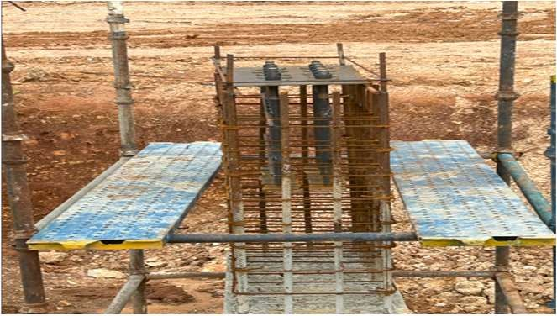
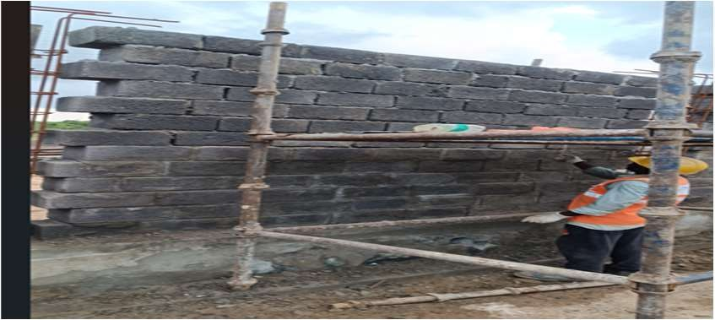
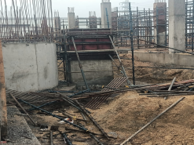
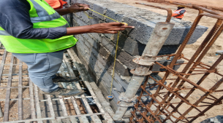
5.1 Opportunity to Improve Site Execution Quality(5/7)
High
u
Medium
LOW
Risk Implication |  |  | n. Misalignment observed at the inspected location: Noted two instances of vertical misalignment was noted: (1) Column reinforcement at J:13 ETP was not aligned with the top reinforcement of the footing, and (2) Compounding wall near Zone:1 was misaligned with the bottom plinth beam, indicating deviations from structural design specifications. Miss alignment Necessary instructions have been issued to ensure proper setting-out, alignment checks, and supervision prior to and during reinforcement fixing to prevent recurrence.
Financial Loss
Controls In- effectiveness | u
Regulatory non – Compliance
Incorrect reporting | u
Improvement | u
Root Cause
Design deficiency | u
Operating ineffectiveness | u
System deficiency | u
Remediation
Formation of SOP / Policy | u
Process Design
Staff Training | u
Defining Role and Responsibility | u
Automate control

Slide 25
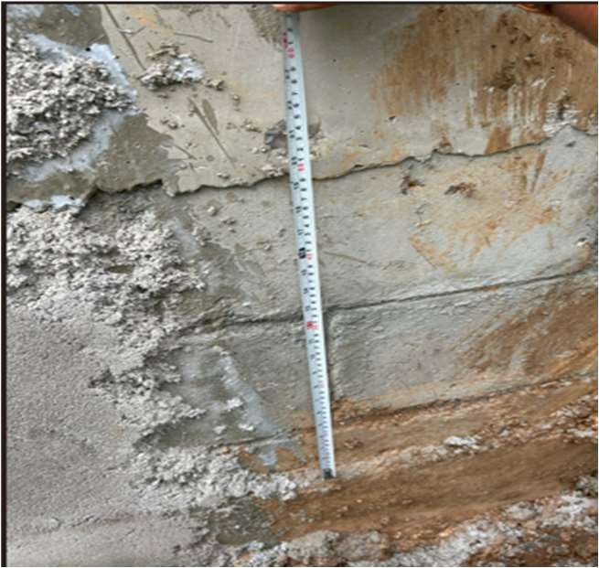
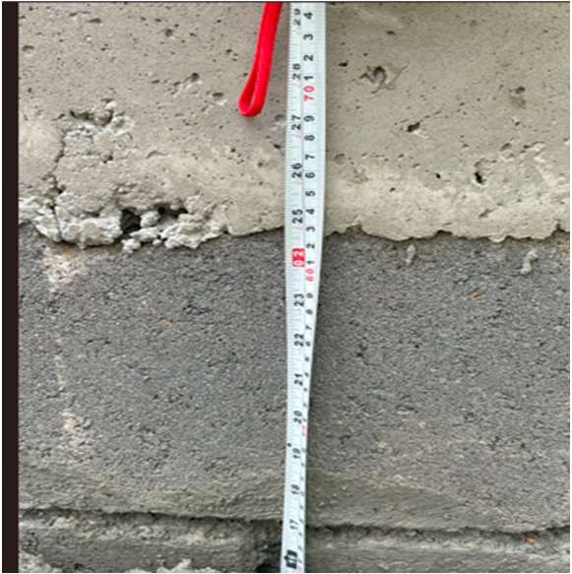
5.1 Opportunity to Improve Site Execution Quality(6/7)
High
u
Medium
LOW
Risk Implication |  |  | r. Execution Deviation from Approved Method Statement: During the review of block wall construction, it was noted that the approved method statement prescribed using three bricks of 200 mm length each with 10 mm mortar joints to achieve a total thickness of 700 mm. However, the remaining 70 mm gap was filled with concrete. Closer Reply :The deviation has been reviewed and addressed. The affected locations have been checked and accepted for structural adequacy, and corrective instructions have been issued to ensure strict adherence to the approved method statement and drawings for all future block wall works. Site engineers and supervisors have been briefed accordingly, and QA/QC supervision has been strengthened.
Financial Loss
Controls In- effectiveness | u
Regulatory non – Compliance
Incorrect reporting | u
Improvement | u
Root Cause
Design deficiency | u
Operating ineffectiveness | u
System deficiency | u
Remediation
Formation of SOP / Policy | u
Process Design
Staff Training | u
Defining Role and Responsibility | u
Automate control

Slide 26
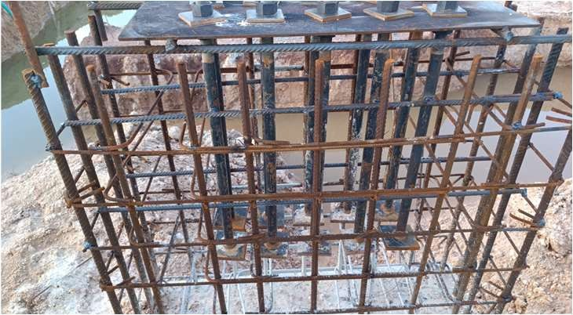
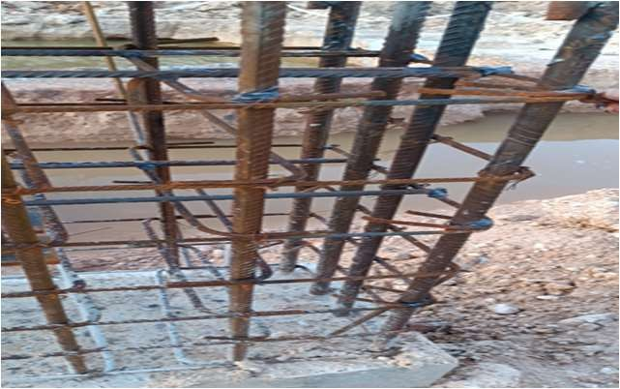
5.1 Opportunity to Improve Site Execution Quality(6/7)
High
u
Medium
LOW
Risk Implication |  |  | Welding was done for fining of anchor bolts and rebars: Noted 3 instances where anchor bolts and rebars were welded for alignment without using couplers or binding wire. Additionally, no detailed specifications were available to validate this practice. Welding was done for the alignment and fixing The welding of anchor bolts and rebars was carried out as per approved site practice and did not affect structural integrity. Extra zig rods were provided to maintain alignment and stability. All welded connections were inspected and found acceptable. Future works will continue to follow approved methods.
Financial Loss
Controls In- effectiveness | u
Regulatory non – Compliance
Incorrect reporting | u
Improvement | u
Root Cause
Design deficiency | u
Operating ineffectiveness | u
System deficiency | u
Remediation
Formation of SOP / Policy | u |  |  | AC1
Process Design
Staff Training | u
Defining Role and Responsibility | u
Automate control

Slide 27
This document contains confidential and proprietary information relating to Protiviti India Member Private Limited and Protiviti Inc. The contents of this document including the information, methodologies, approach and concepts contained herein are confidential and are intended solely for the use by persons within the addressee’s organization who are designated to evaluate capability of Protiviti India Member Private Limited to provide services. This document should not be shared with any third party or used for any other purpose or in any inappropriate manner.

